Slide 1
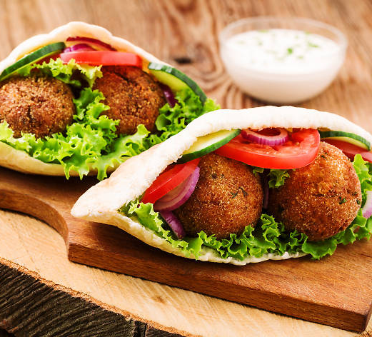
IBM Data Science Capstone Project The Battle of Neighborhoods
Finding the best place to open Falafel and Middle east vegan restaurant in Berlin
By
Nedal Shami

Slide 2
Background and problem
Berlin is the capital and largest city of Germany
Berlin is well known for its offerings of vegetarian and vegan cuisine and is home to an innovative entrepreneurial food
it is one of the potential places for the success of this type of restaurant (Falafel and Middle east vegan restaurant)
In this project we will explore Berlin city to find out where the most appropriate place to open a Flafel Middle east vegan food.

Slide 3
Methodology
Data was scraped and cleaned, and features selection was made.
Map created for neighborhood of Berlin
We use Foursquare API was used to figure out all neighborhood venues in Berlin.
Neighborhoods are classified using K-means unsupervised ML algorithm.

Slide 4
Data
The main data sources are:
Wikipedia, which provide a list of districts and neighborhoods of Berlin at:
https://en.wikipedia.org/wiki/Boroughs_and_neighborhoods_of_Berlin
Venues data from Foursquare API

Slide 5
Data acquisition and cleaning:
We use web scraping techniques to get data from the web (Wikipedia)
Convert data to Pandas dataframe, and structure all data in one table.
Clean data (remove unwanted columns and remove the unneeded characters from some columns).
Using geopy library to add latitude and longitude to each neighborhood.
Use Foursquare API to get venues for each neighborhood. To make it simpler we set a limit to 100 venues with radius of 1000 meters of every neighborhood.

Slide 6
Classifying neighborhoods
Using unsupervised learning (K-means) to classify neighborhoods:
Create one-hot encoding to the venue’s category for each neighborhood.
Calculate the frequency of categories for each neighborhood and get the top 5 most common venues in each neighborhood.
We use K-means clustering algorithm to classify neighborhood, we choose k to be 5 clusters.
We plot the clustered neighborhood to visually illustrate it.

Slide 7
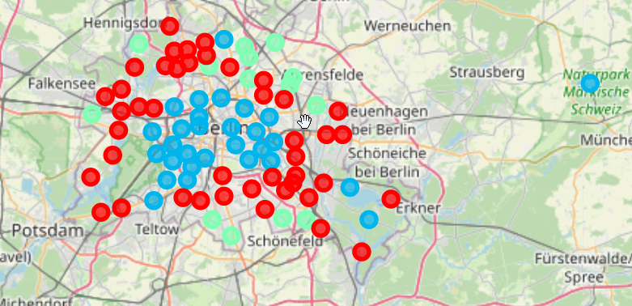

Slide 8
Results and conclusion:
Obviously, there are three main clusters:
Cluster 0 with Red color on the map.
cluster 2 with blue color.
cluster 3 with green color
the other two clusters seem located in remote areas, and they are - definitely- not in our target.

Slide 9
Final Result
Neighborhoods that are classified as cluster 2 are seems good candidates of our target, especially that we see from our examining to this cluster that there are a few restaurants that offers Falafel and Middle east food.

